Slide 1
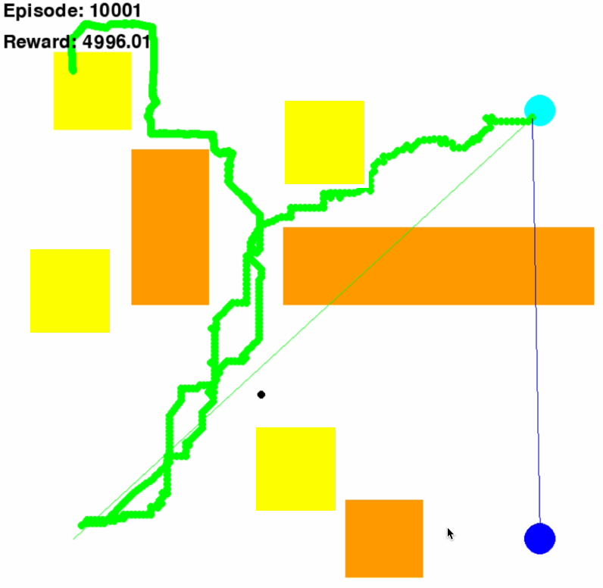


D
C : Customer
D : Depot
E : Emergency
Obstacle
Congestion Zone
C
E

Slide 2
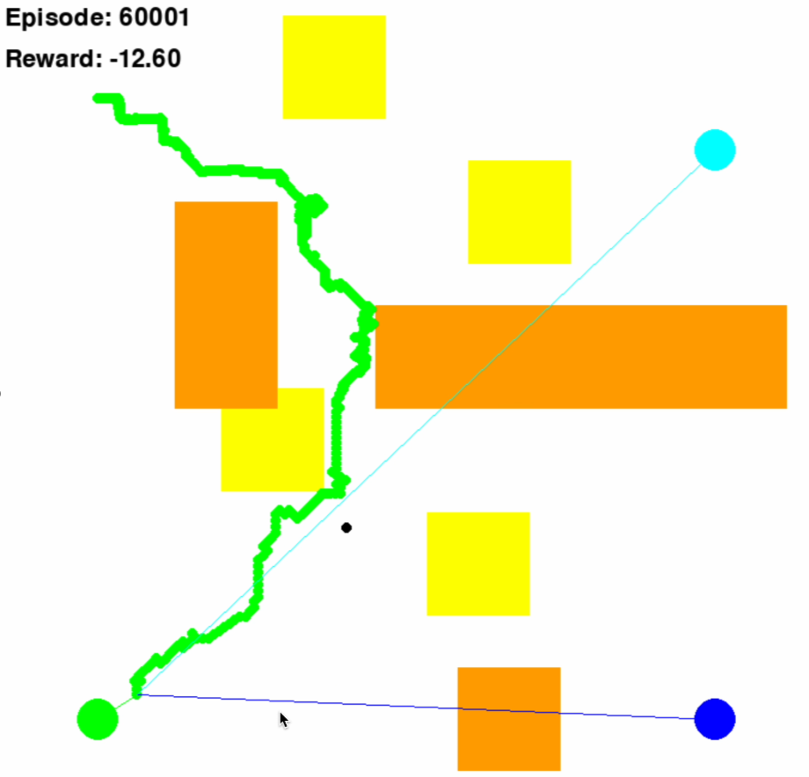
D
C : Customer
D : Depot
E : Emergency
Obstacle
Congestion Zone
C
E

Slide 3
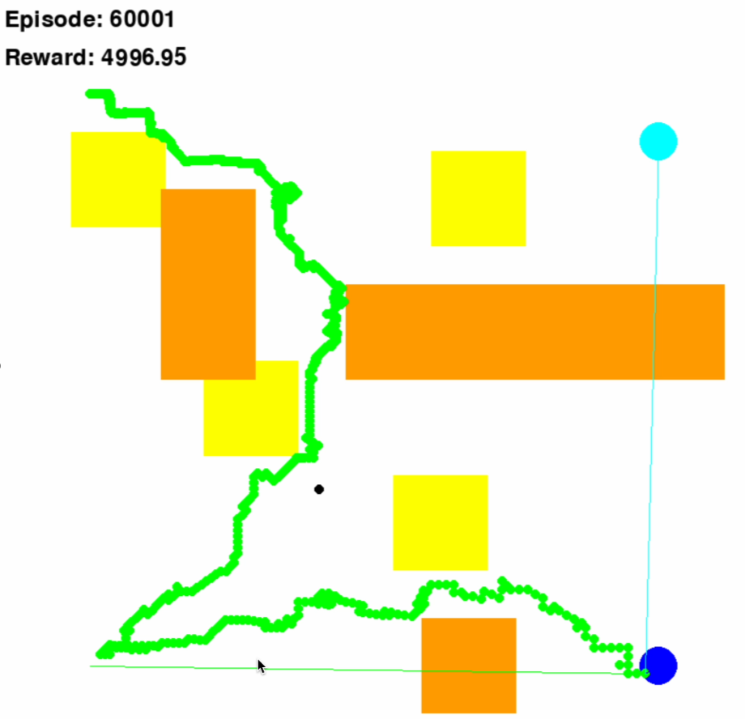
D
C : Customer
D : Depot
E : Emergency
Obstacle
Congestion Zone
C
E

Slide 4
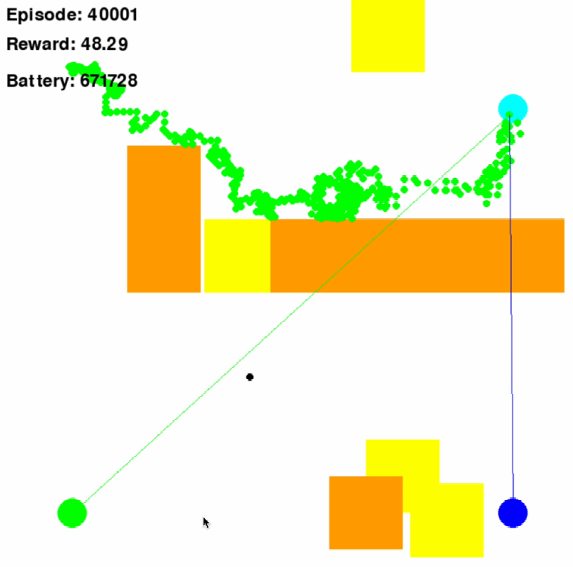
D
C : Customer
D : Depot
E : Emergency
Obstacle
Congestion Zone
C
E

